Slide 1
Sprint 2 : 360 Job Search

Slide 2
What will be covered
Remaining stories from sprint 1
What we accomplished within sprint 2
Architectural Design
Test cases (functional/non functional)
Protractor - Is an end to end framework for Angular against your applicant running in a real browser. (It uses Selenium to automate browser behavior)

Slide 3
What we did
Real-Time Messaging
Generate Recommendations for Users
Top Recommendations for Users logged and not logged in
Rank Applicants
Recruiters viewing their applicants
Applicants having the ability to view the jobs they applied to
Selenium e2e testing

Slide 4
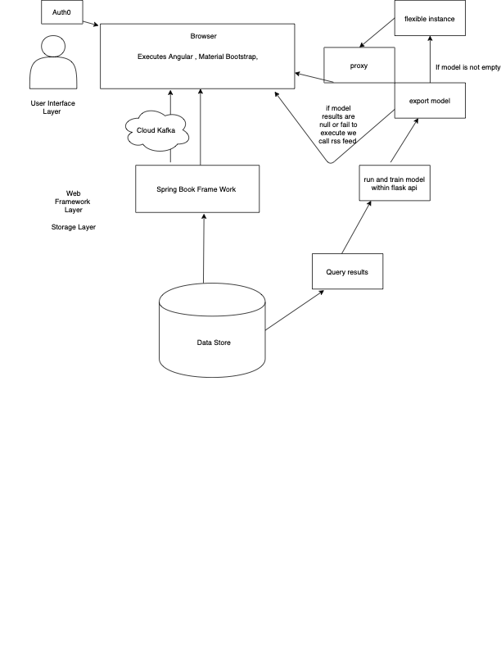
Architecture

Slide 5
Demo + Talking about use cases
Utilizing Protractor:
Protractor is an end-to-end test framework for Angular and AngularJS ... The webdriver-manager is a helper tool to easily get an instance of a Selenium Server .
Use Cases:
Do we get the welcome page?
Do we get unique recommendations - (how do we handle this)
Do we get our jobs
View my applicants
View jobs button
Support Page accessible
Applying to a job - (test should fail)

